Slide 1

OrbitWatch
by OKKM
Notes:
Good Morning.
We’re the OKKM Team which stands for Oleg, Kyle Kartik and Mathew
Today, we’d like to unveil a platform that transforms raw satellite imagery into actionable intelligence—powered by AI and crowdsourcing.
Let’s dive into how we’re solving a critical gap in satellite data analysis.

Slide 2
Roadmap
1. The Problem
2. Our Solution
3. Demo
4. Overview of Implementation
5. Looking ahead
6. Costs
/ 32
Notes:
Here’s what we will cover today

Slide 3
The Problem:
Bottleneck in Geospatial Data
Exponential Data Growth
Manual Labeling Bottleneck
AI Model Limitations
Satellite imagery availability has increased 10x since 2015.
High manual labeling costs per image, slow and inconsistent.
Lack of quality labeled data for critical use cases.
Example: Monitoring deforestation requires analyzing 10,000 sq km weekly. [1]
/ 32
Notes:
Industries like disaster response, agriculture, and urban planning all rely on satellite imagery—but there’s a catch: high-quality labeled datasets are scarce, expensive, and slow to produce.
Manual labeling requires experts, costs thousands, and takes weeks. This bottleneck delays critical decisions evident by the lag between availability of data --- and --- the derived insights.
Our platform solves this by combining Computer Vision insights with crowdsourced labeling—cutting time and cost by 90% or more.

Slide 4



Our Solution:
AI-Powered Data Labeling Platform
Streamlined, Fast Workflow
From image ingestion to validated labels.
Scalable Platform
Handles large volumes of imagery and labelers.
Precise Annotations
Accurate output datasets.
/ 32
Notes:
Lets start with the big picture:
OrbitWatch is a web platform where clients submit satellite images, and our hybrid AI & crowdsourcing pipeline delivers labeled datasets in days, not months.

Slide 5
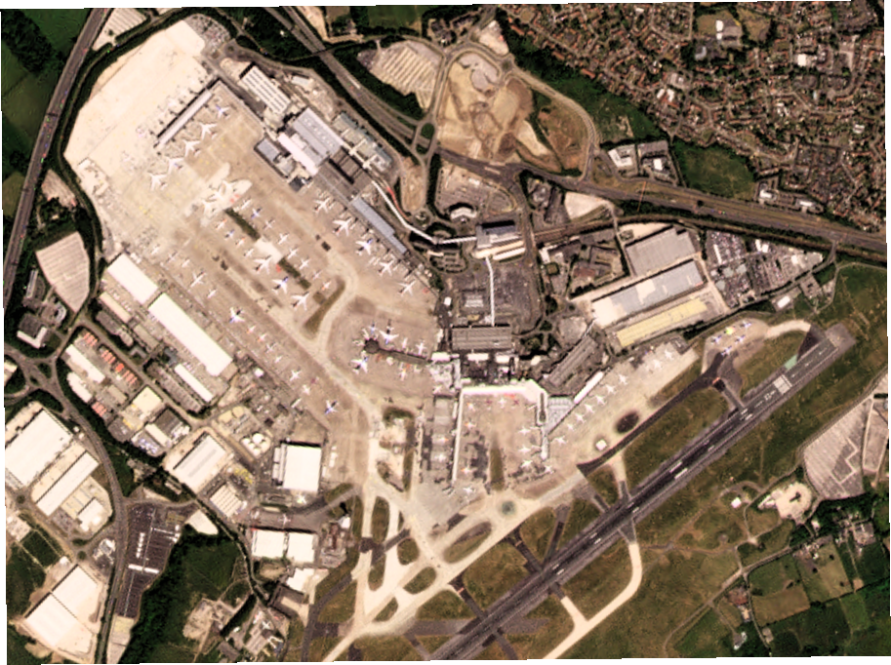
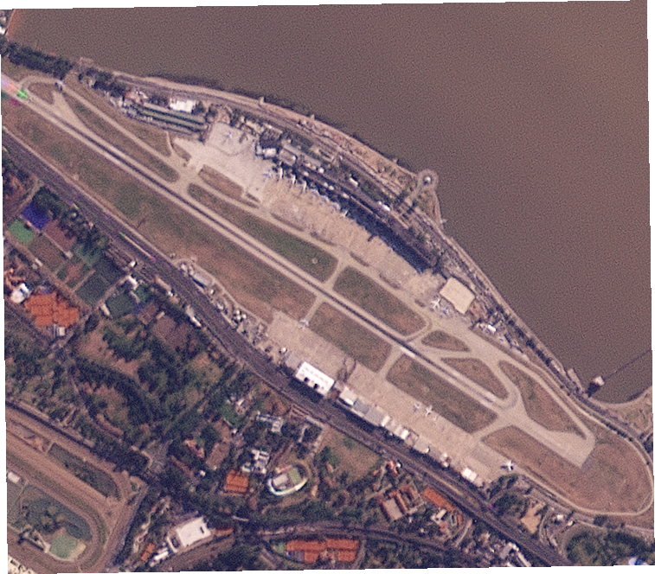
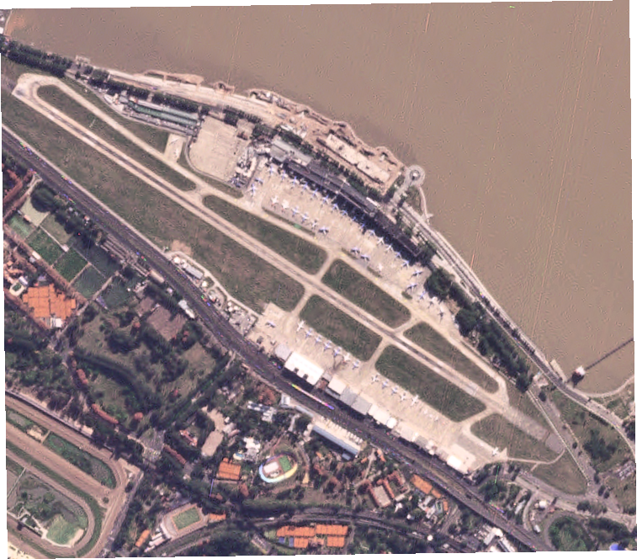
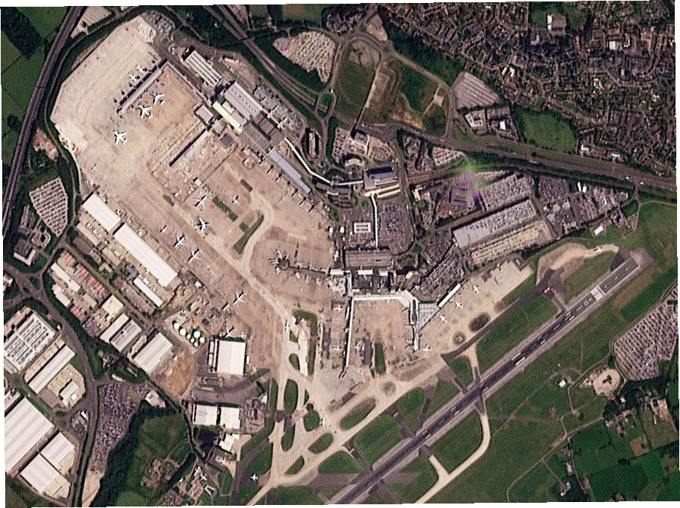
/ 32
Notes:
You may have heard of hedge funds using satellite imagery to count cars in Walmart parking lots—predicting quarterly earnings based on traffic. Today, we’ll show how our platform enables similar alternative financial insights, but with a twist: tracking airport recovery post-pandemic.
Traditional methods—like FAA reports or airline disclosures—lag by weeks. Our platform delivers these insights in hours.
Let’s see this live.

Slide 6






Data Pipeline: From Image to Labeled Data
Image Upload
Planet Labs, etc.
Image partitioning
Cost & accuracy optimization
AI Pre-Analysis
Object detection
User Labeling
Label toolkit
Confidence Scoring
Consensus model
Report Generation
Data Delivery
/ 32
Notes:
This is our complete data pipeline. For the demo we will walk you through each step of the process.

Slide 7
LIVE DEMO SHOWCASE ALL THE PIPELINE
/ 32

Slide 8
Integration with Planet Labs
1
Direct API integration
Real-time image access.
2
24-hour turnaround
SkySat and RapidEye.
3
Automated image processing
Reduces manual handling.
/ 32
Notes:
We are partnered with Planet Labs for real-time, high-res imagery. Their API allows us and our clients to access specific images - fast.
When this integration is fully implemented, it further reduces the lag between requests and actionable insights.

Slide 9
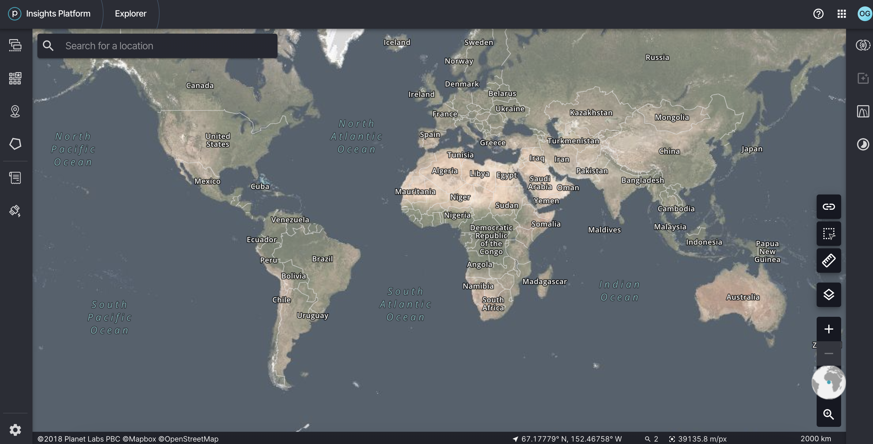
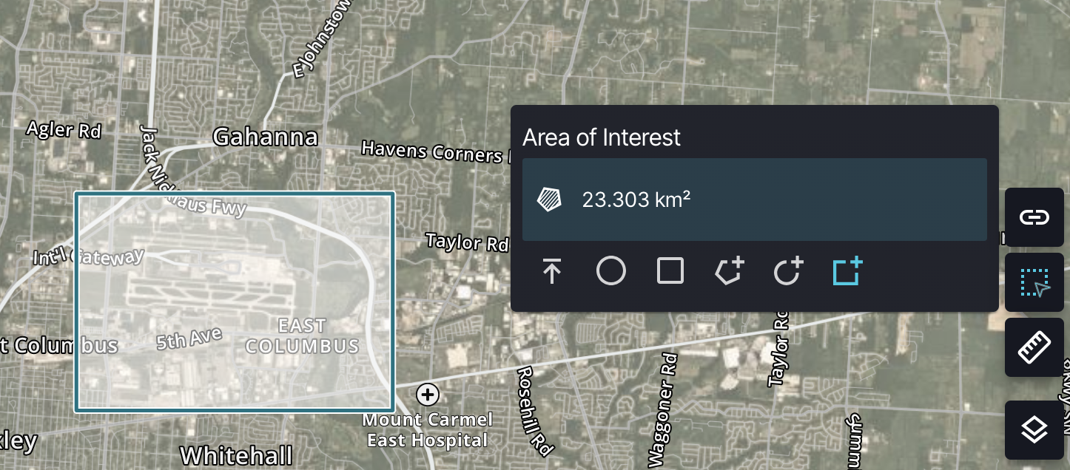
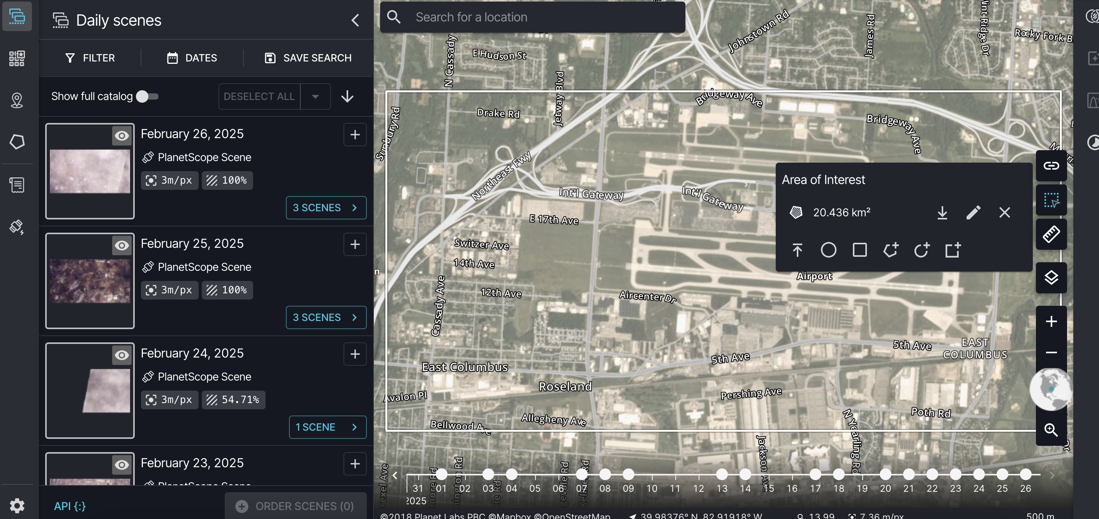
/ 32
Notes:
Quickly walk you through this process, done manually

Slide 10
AI Pre-Analysis:
Focus on What Matters
Object detection
Airplanes, buildings, crops.
Reduces manual search
Improves efficiency.
Areas of Interest (AOIs)
Identification of locations.
/ 32
Notes:
AI model trained on prior labeled datasets flags regions needing attention (e.g., deforestation, urban sprawl).
Demo: Overlay heatmap on raw image showing high-priority zones.
Reduces labeling effort by 30% (hypothetical metric).

Slide 11

Preprocessing
/ 32

Slide 12
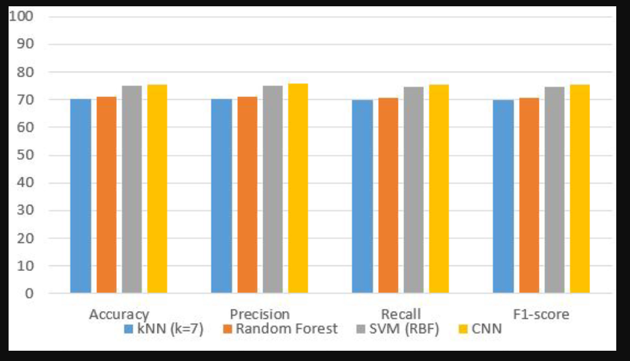
Model Choice

Slide 13
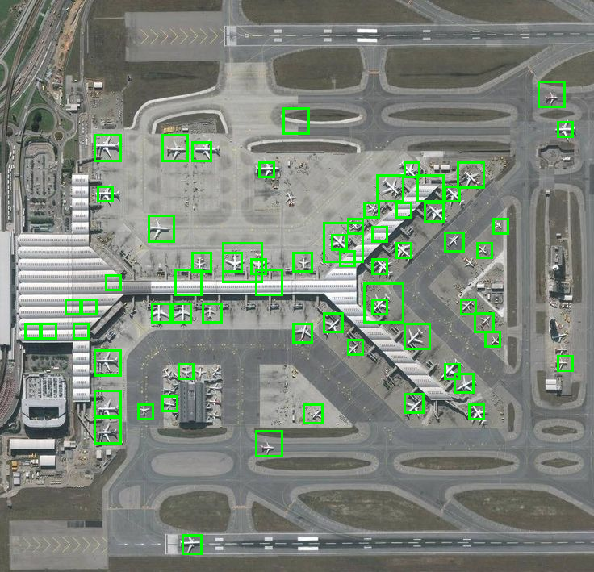
Output
/ 32

Slide 14
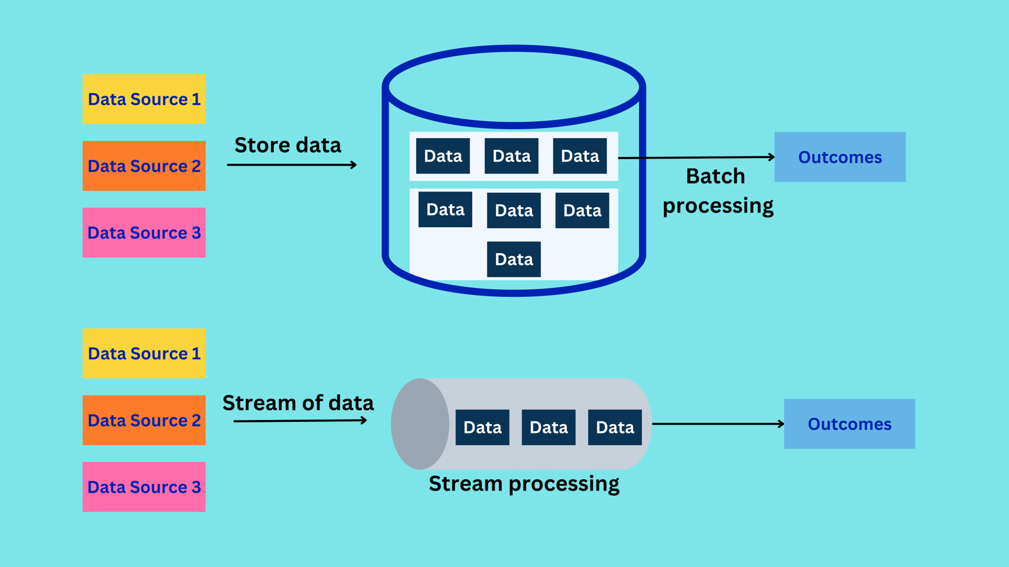
Batch Processing
/ 32

Slide 15
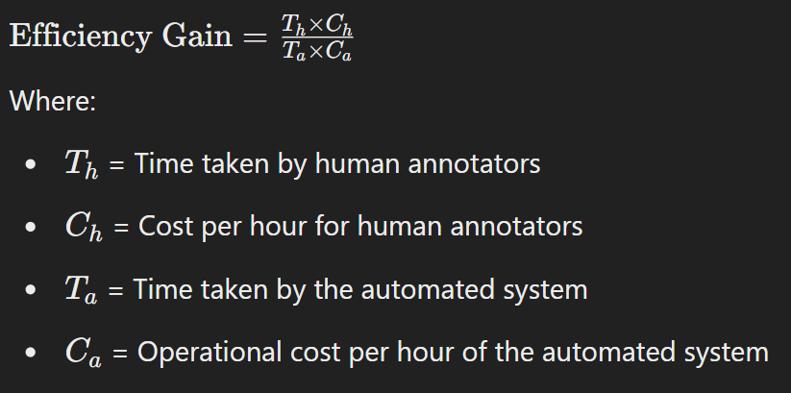
Time and Cost Analysis
/ 32

Slide 16
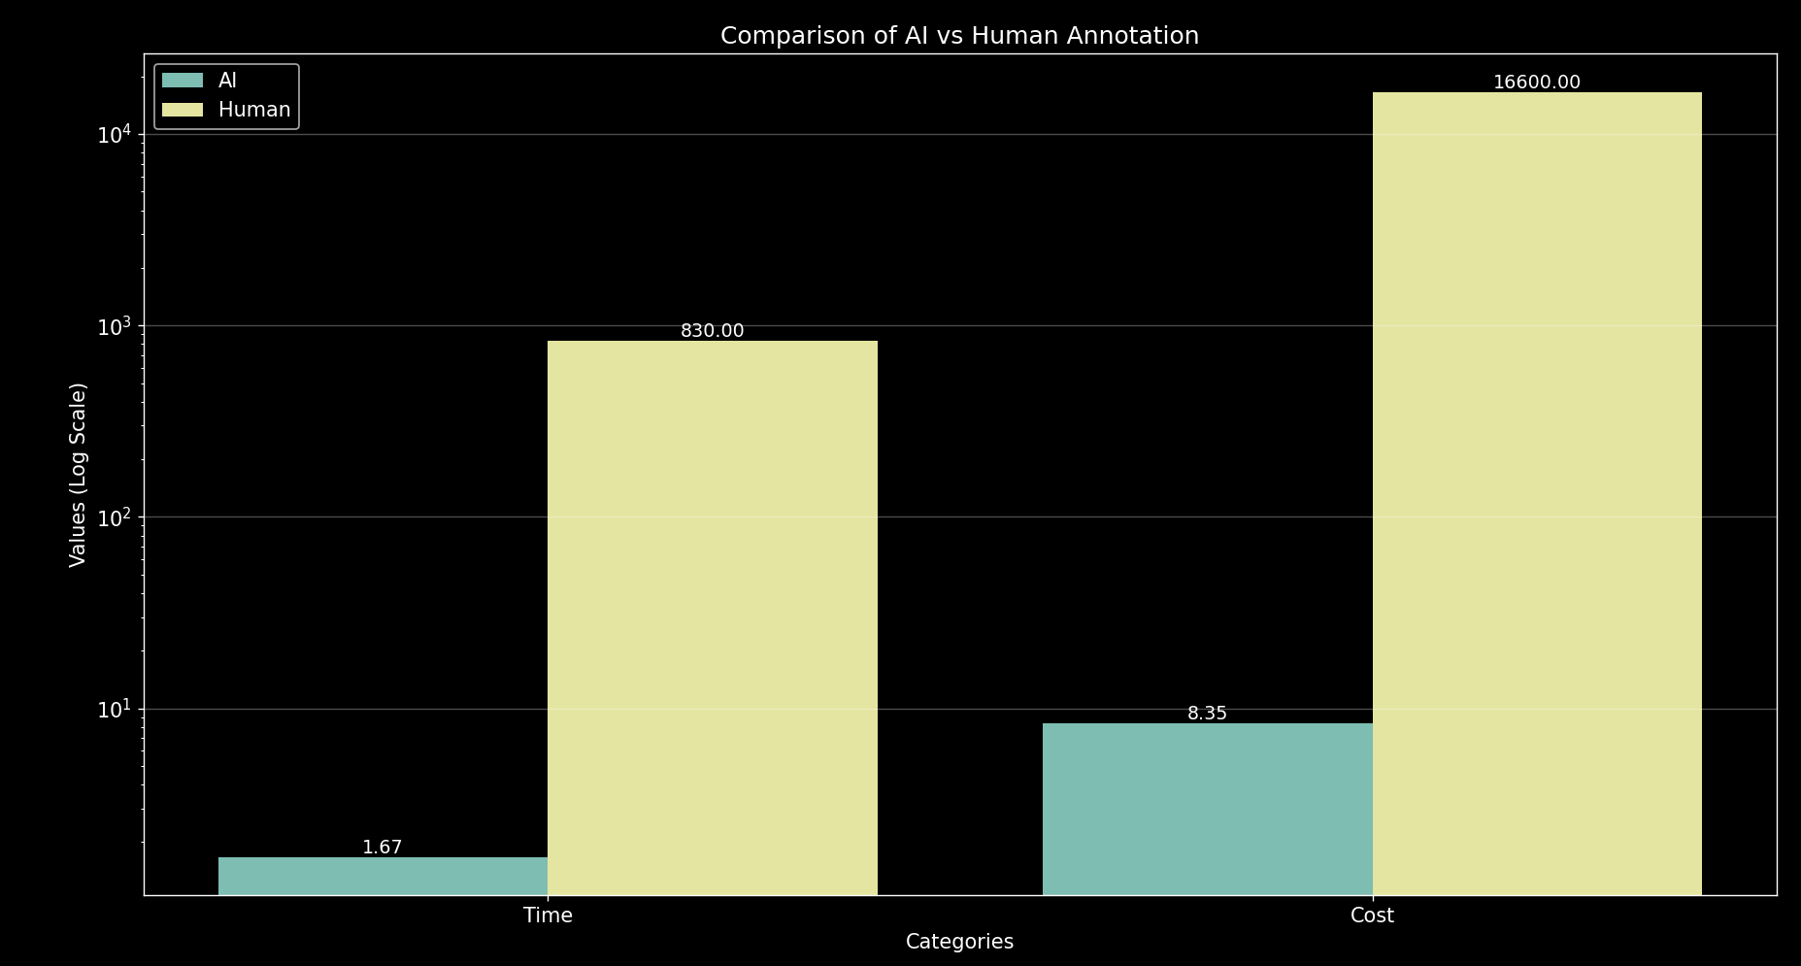
Evaluation

Slide 17
Image Dissection:
Reducing costs
1
Image size
f
2
Satellite resolution
3
Object dimensions
Labelers complete 200 annotations per hour.
/ 32
Notes:
Our algorithm dynamically adjusts tile size based on object complexity. To manipulate the tiles we rely on these three parameters
Image size in px
Sat resolution (currently we’re working with 3px/m and a high-res 0.5px/m)
Object dimenstion (think, ships vs cars)

Slide 18
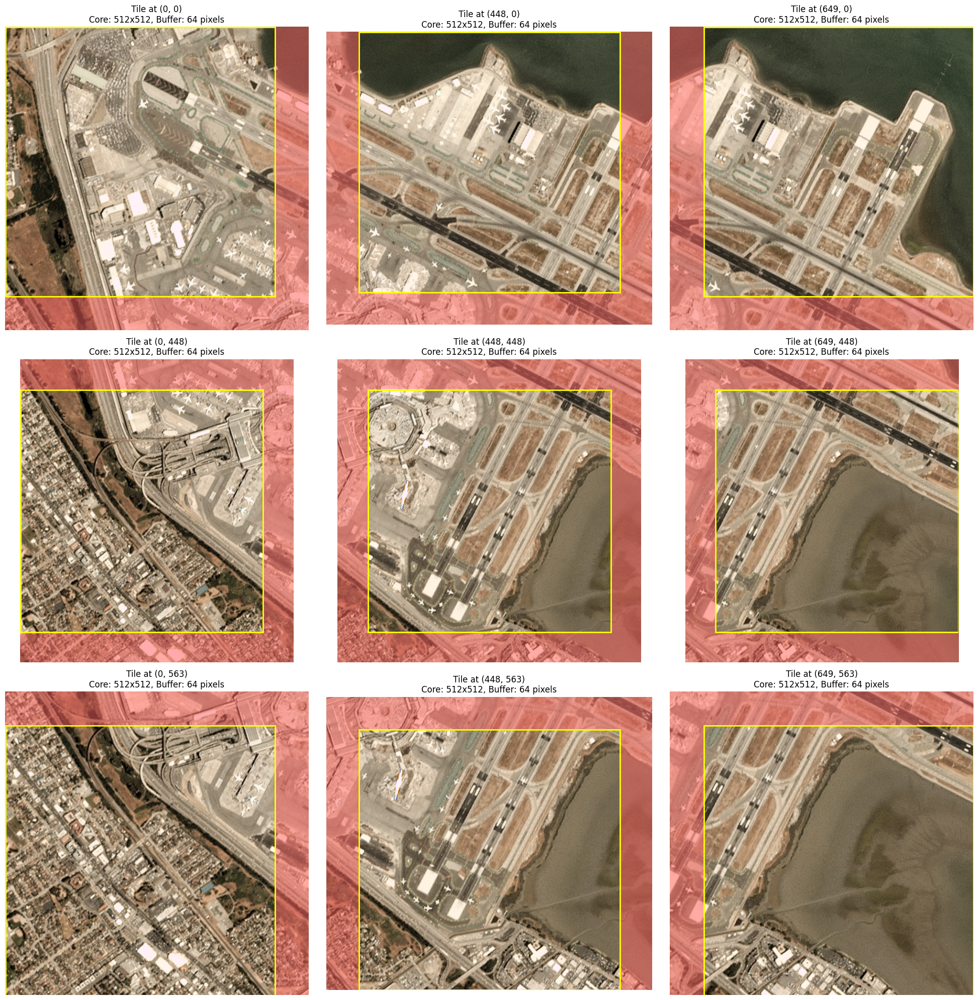
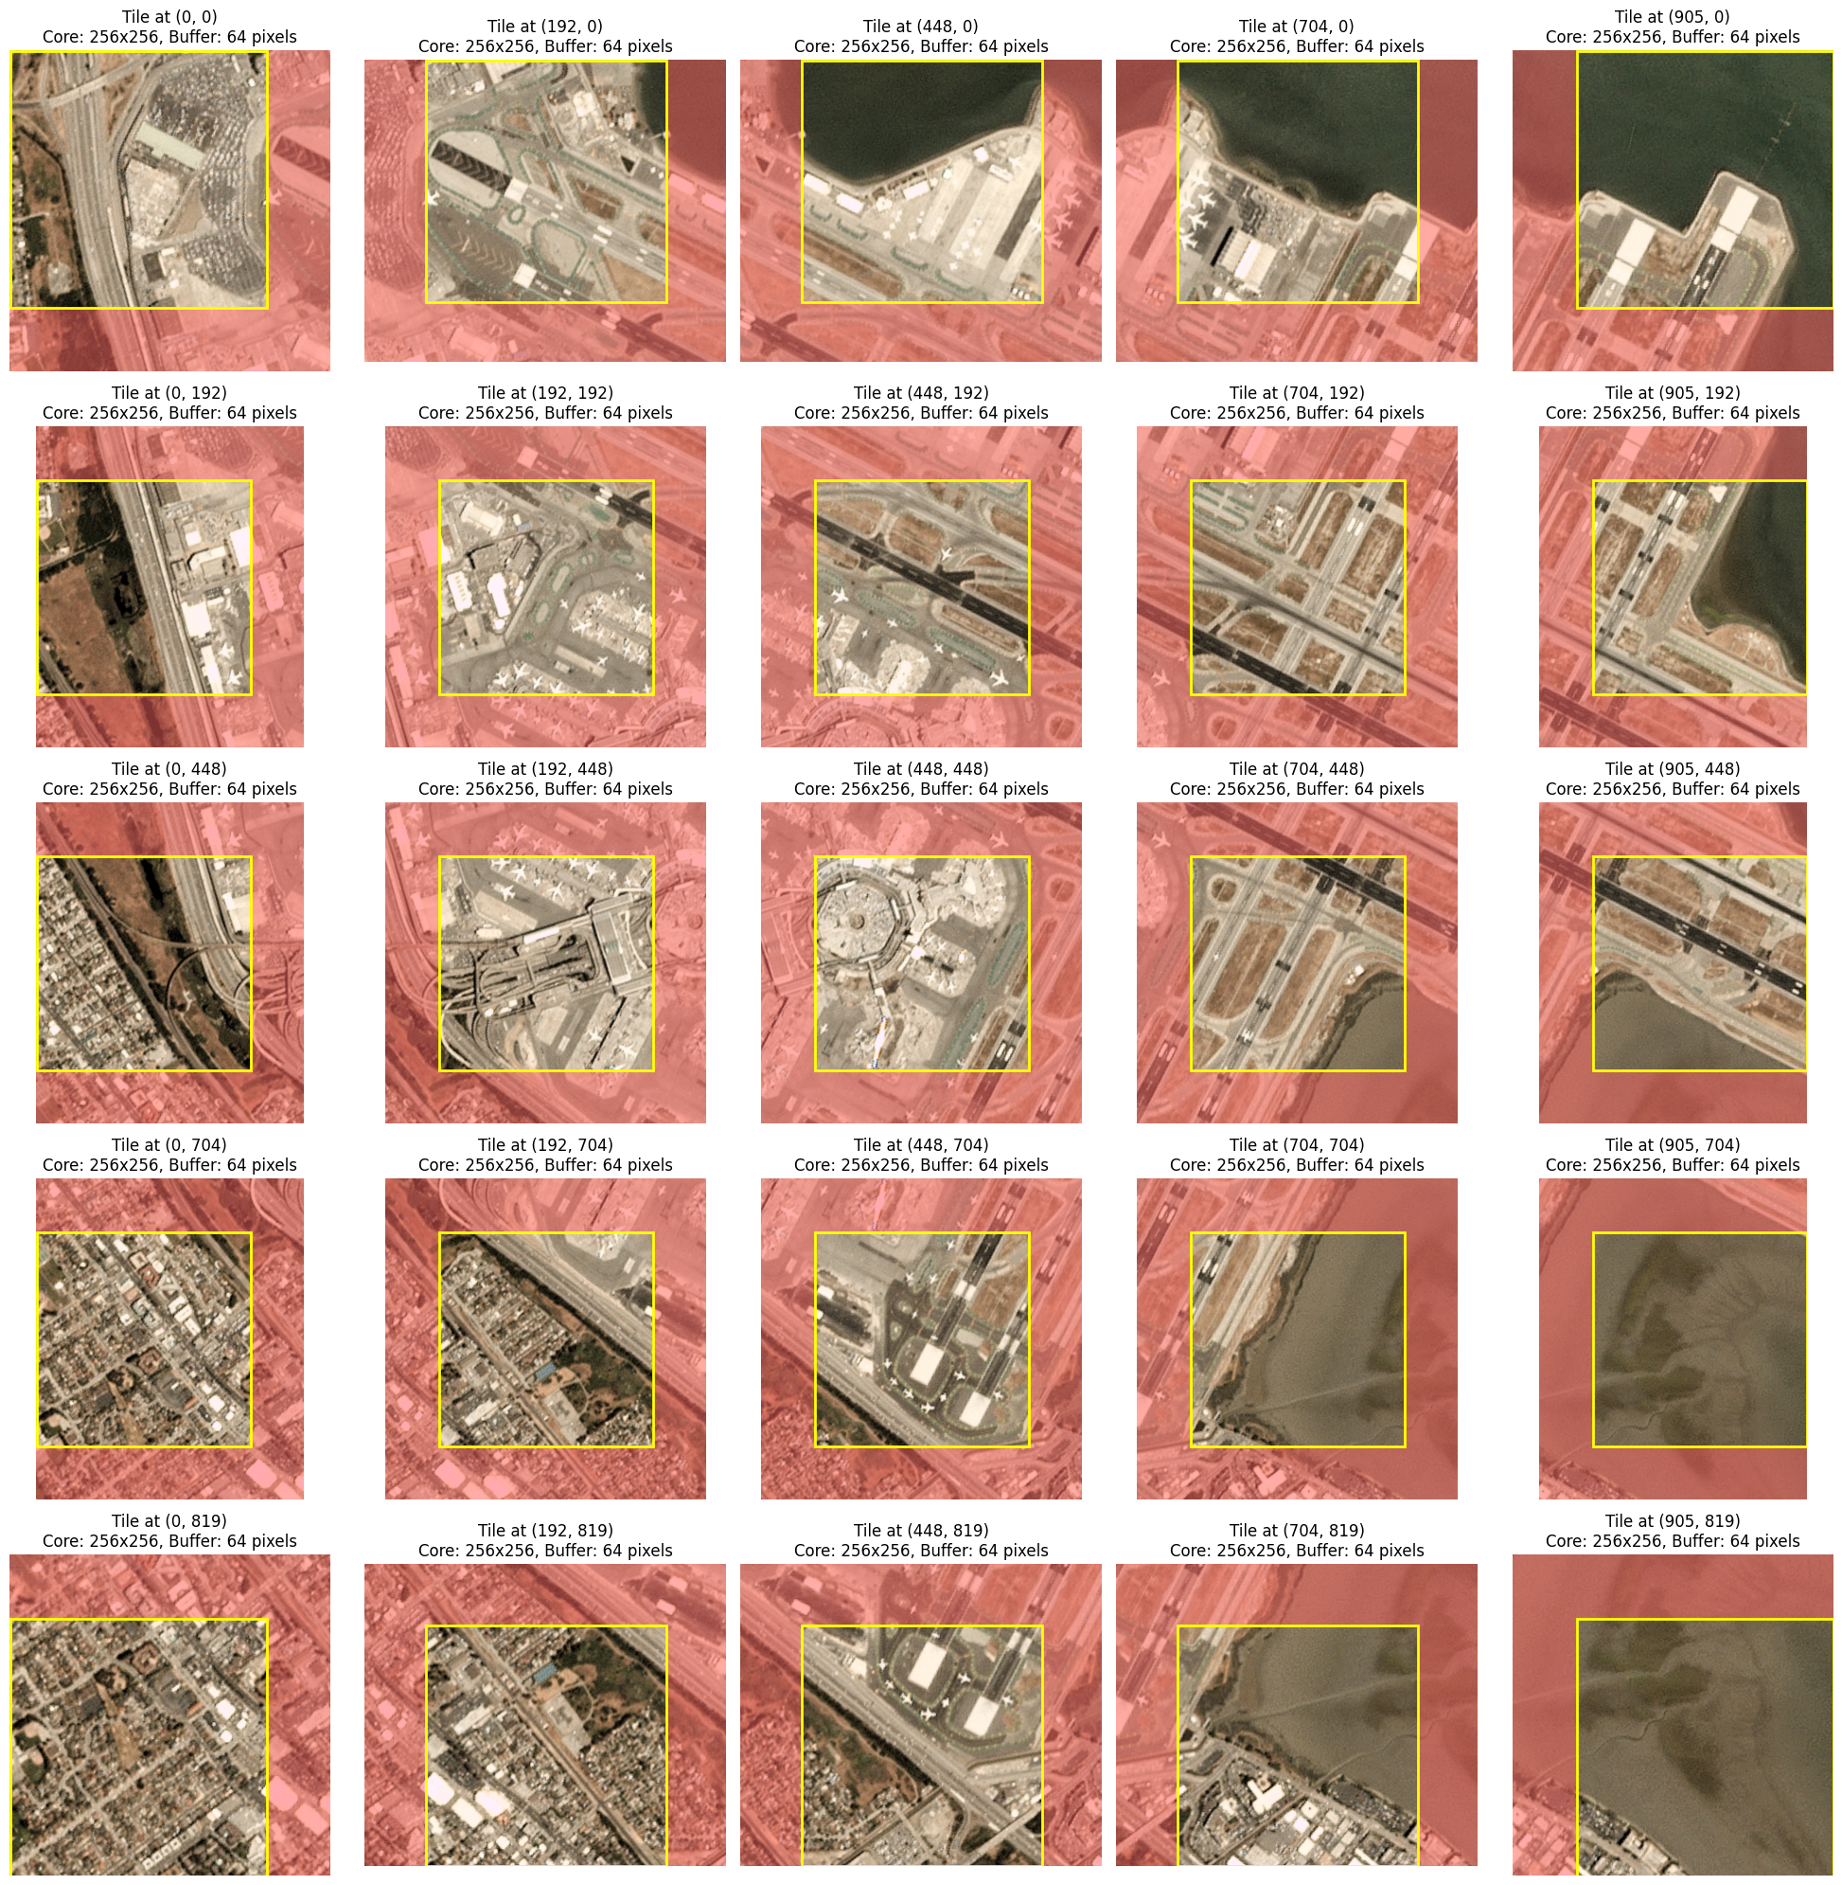
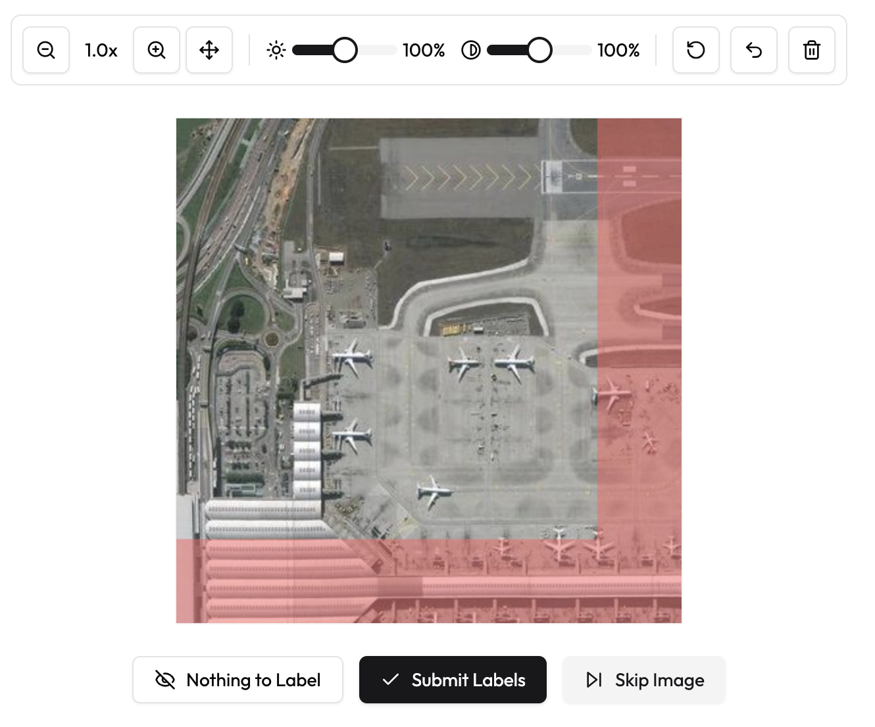
/ 32
Notes:
For example, here we are varying the Object dimensions parameter. The number of object we believe to fit on a screen back-to-back.
In short:
Smaller tiles = higher accuracy but higher cost (more labels needed). Larger tiles = faster/cheaper but may miss details.

Slide 19
Labeling Interface
Annotation tools
1
Useful features to enhance labeler performance
Custom Made Labeling Tool
2
Enables flexible development and eliminates restrictions
User-friendly
3
Fast, accurate labeling and step-by-step
tool overview
/ 32
Notes:
Features: Zoom, preset labels, quality checks.
Compensation model: Pay-per-viewed-tile
Custom Labeling Component: Makes it easier, talk about the restrictions of having to use a prebuilt component

Slide 20




Old Design
Readability
4.6/5
Visual Feedback
2.2/5
Navigation
3.4/5
Ease of Labeling
3/5
Using a prebuilt tool led to limitations in our ability to control the features and make them usable
/ 32

Slide 21
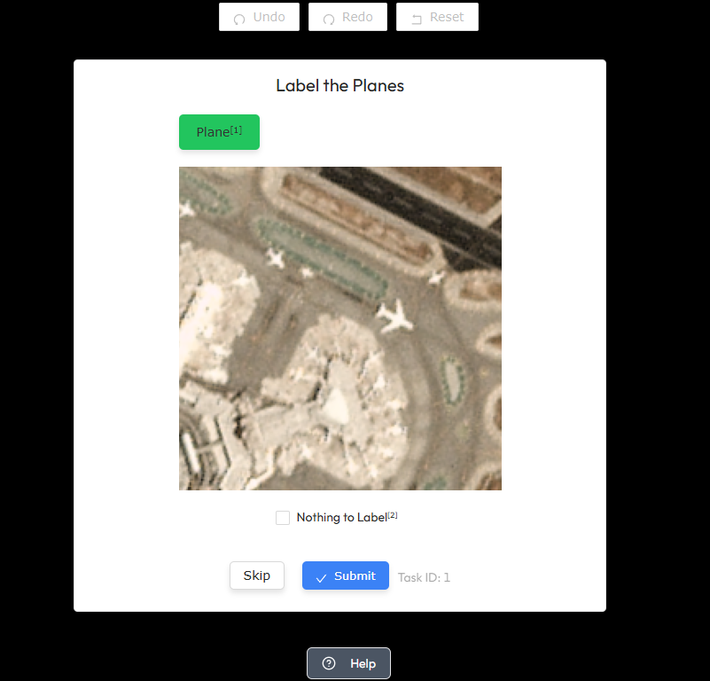
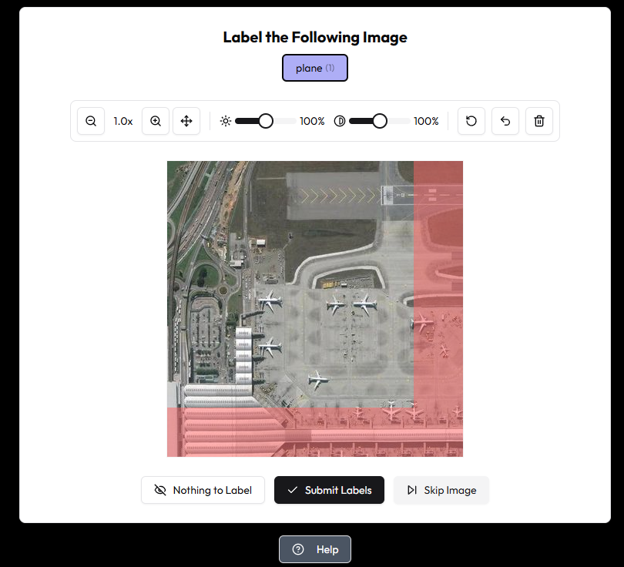

Custom Made Design
/ 32

Slide 22
Usability
Key Features
Clear text labels and tool tips
Label classes stay selected
Consolidated tool bar
Upgraded Tutorial
Shortcuts
Visual feedback on buttons
Clear error indicators and feedback for bad inputs
Readability
4.8/5
Visual Feedback
4.4/5
Navigation
4.8/5
Ease of Labeling
4.4/5
/ 32

Slide 23









Collect Labels
Generate predictions
Calculate Confidence
Update User Expertise
Extract Objects
Check if finished
Consensus Model
Goal: Infer the ‘type’ of objects found
in an image using user-labels.
Bayesian Inference with confidence update:
Burke & Klien 2021
Confident in the Crowd: Bayesian Inference to Improve Data Labelling in Crowdsourcing: Burke & Klien 2021
/ 32
Notes:
2020 paper by Burke and Klien
Bayesian based aggregation for binary classification tasks
- updates user weight based on confidence in prediction
Better accuracy, more efficient Labeling (faster convergence)
Better performance against adversarial workers – if people are trying to make bad predictions, it hardly considers them
-

Slide 24


Consensus Model Benefits
Accurate Labels
Rapid Convergence
Robust to Outliers
Model shows best performance over alternatives for tasks requiring high-confidence
Converges faster than non-probabilistic models, saving labelling time and effort
Intentional or not, poor performers provide minimal impact to predictions
Confident in the Crowd: Bayesian Inference to Improve Data Labelling in Crowdsourcing: Burke & Klien 2021
/ 32
Notes:
2020 paper by Burke and Klien
Bayesian based aggregation for binary classification tasks
- updates user weight based on confidence in prediction
Better accuracy, more efficient Labeling (faster convergence)
Better performance against adversarial workers – if people are trying to make bad predictions, it hardly considers them
-

Slide 25
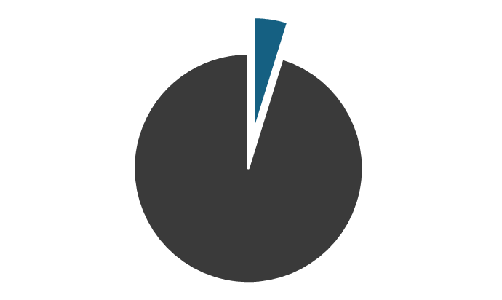

Hardware Optimized Engine
More frequent aggregation
Better data availability
More efficient image serving
Higher accuracy
95% Reduction
In Energy Usage
4833 mWh vs 233 mWh
Ryzen 5 7600X, RTX 3808, DDR5-5600
/ 32
Notes:
Left side – show performance improvements going from CPU to GPU
Enabled:
more frequent aggregation
Confidence based image serving
Efficient computing (talk about reduction in Power)

Slide 26
The money question:
Revenue model
1
Client Fees
Client pay X; cost of manual labelling Y; image procurement is Z
Difference is the revenue.
2
Client Labeler Ecosystem
Pay-per-image or subscription model for datasets
Market size of data labeling $17.0B by 2030 [2].
/ 32
Notes:
Now you might have noticed the mention of costs associated with the a project.
Our revenue model is designed to capitalize on the explosive growth of the satellite data market—projected to reach $17 billion by 2030
We propose two revenue models:

Slide 27
Looking ahead:
Scalability & Future Growth
Object tracking
New data sources
Smarter decisions
/ 32
Notes:
Now on to the next steps for us:
- Smarter decisions – increase the reliance on AI generated labels
Multi-source integration (weather or others forms of sat images).
Object tracking (either through time or space)

Slide 28
OrbitWatch
Oleg Glotov
Kyle McMaster
Kartik Chaudhari
Mathew Petronilho
brought to you by OKKM

Slide 29
Appendix
/ 32

Slide 30
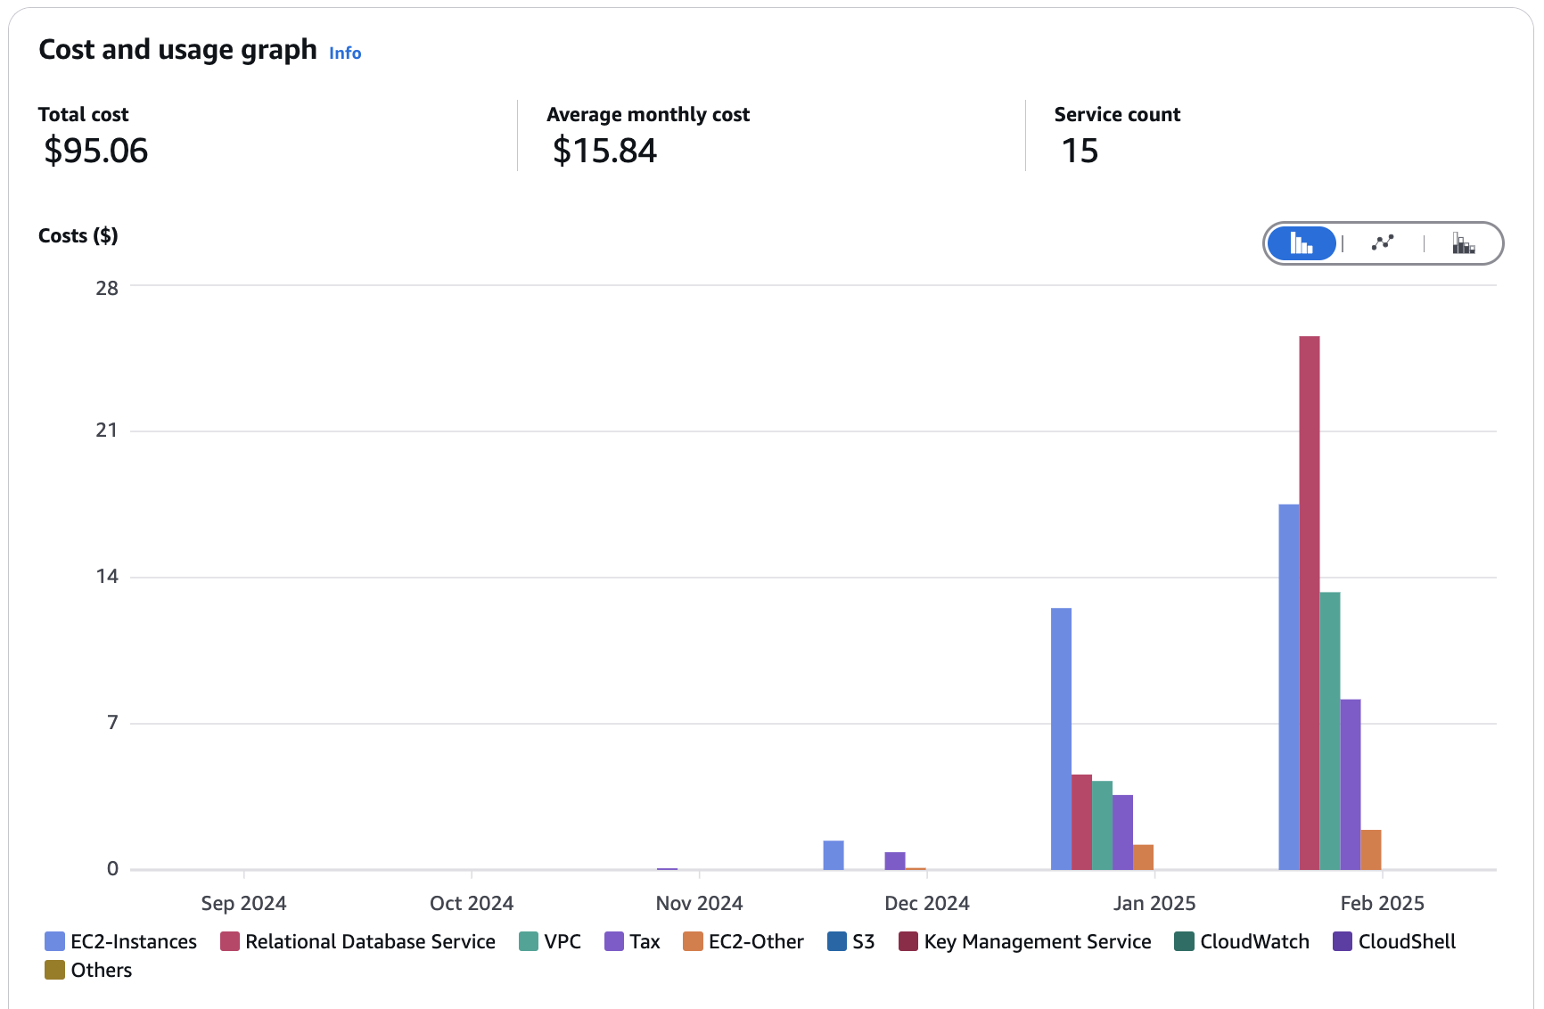
Cost breakdown
/ 32
Notes:
AWS project costs
-

Slide 31
References
1 – https://earthdata.nasa.gov
2 - https://www.grandviewresearch.com/industry-analysis/data-collection-labeling-maket
/ 32
Notes:
AWS project costs
-

Slide 32
The end
/ 32

